Slide 1
Choosing our Comfort Champion
UCalgary Sustainability Moment
Notes:
Hello there, and welcome to “Choosing Our Comfort Champion”! This Sustainability Moment outlines the role of the Comfort Champion in balancing thermal comfort with energy efficiency in the workplace. Thank you for sharing this presentation with your colleagues.
Use this Sustainability Moment to help start a conversation about thermal comfort and energy efficiency in your workplace. If you have already appointed a Comfort Champion in your office, sharing this presentation is a great way to announce who that person is and to decide how to communicate with them. If you haven’t appointed a Comfort Champion yet, this Sustainability Moment can be used as a call for volunteers.
If you have any questions about this presentation or how to share it, please do not hesitate to contact sustain@ucalgary.ca

Slide 2
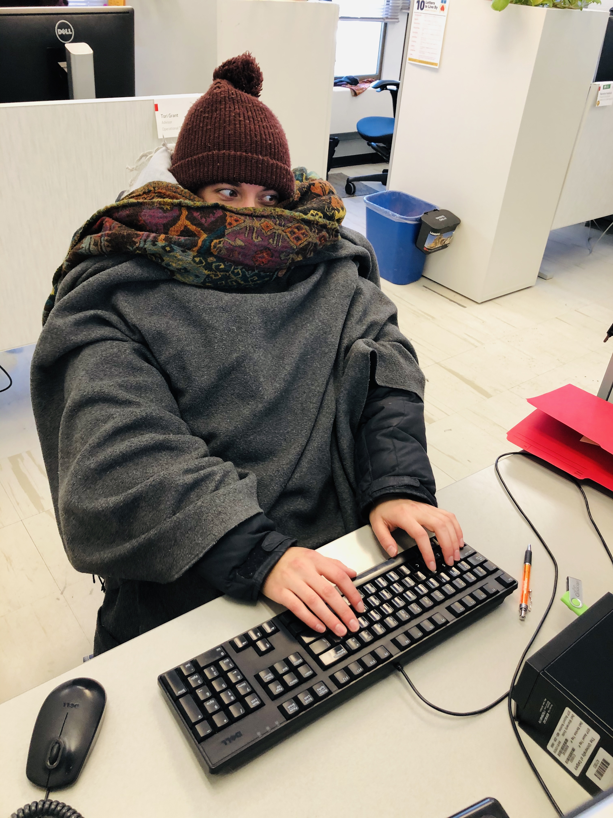
Choose: thermal comfort or energy efficiency?
UCalgary thermostats are set to maintain a temperature range that balances comfort and energy efficiency
  Using space heaters, opening windows, or adjusting the thermostat disrupts this ideal range, wasting energy …
  … but an office that’s always too hot or cold may mean that systems aren’t working and that energy is being wasted

Slide 3
Appointing a Comfort Champion can help us balance thermal comfort with energy efficiency!

Slide 4

What is a Comfort Champion?
A Comfort Champion serves as the single point of contact for a work area’s temperature concerns
This volunteer:
  Collects feedback from colleagues about temperature concerns in the office
  Meets with their Facilities Manager to discuss when and how to operate their work area’s thermostat
  Adjusts the temperature (if necessary)
  Submits repair requests through ARCHIBUS (if necessary)

Slide 5

Why do we need a Comfort Champion?
Having a single point of contact simplifies tracking, reporting and repairs:
  Everyone knows who to contact with temperature concerns
  It’s easier to identify a pattern when all concerns are reported to the same person
  Simplifies communication between our office and Facilities Customer Care
  No more thermostat wars – and less wasted energy!

Slide 6
Do you have what it takes to be our Comfort Champion?
To volunteer, contact [Lead Program Contact].
Notes:
You may find it worthwhile to appoint a Comfort Champion based on their proximity to your office’s temperature controls, rather than seeking a volunteer. If you have already appointed a Comfort Champion, please adapt this slide to share their contact information with your colleagues.

Slide 7
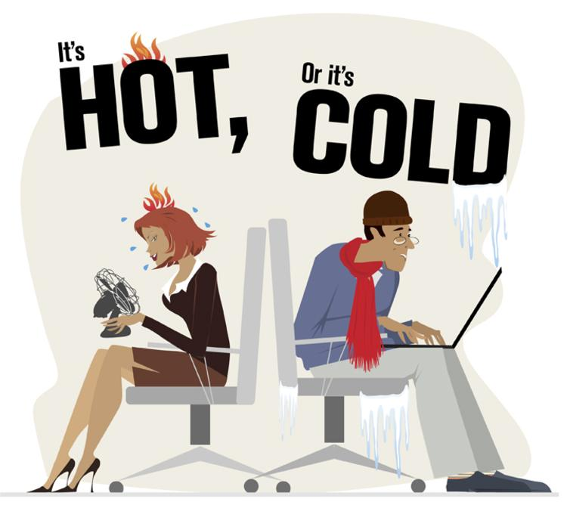
Discussion
What’s the best way to communicate our concerns to our Comfort Champion?
If some people in our office are too warm and others are too cold, what could we do to keep everyone comfortable without adjusting the temperature?
Notes:
Discussing these question as a group will help you and your colleagues to communicate effectively with your Comfort Champion and to identify solutions that will support you in your specific working environment.
If you’re stuck: one compromise solution that has worked well in offices with “hot” and “cold” spots is to reassign seating based on cold tolerance. If coworkers who are always too warm are seated under a heating vent, they are likely to appreciate the chance to swap desks with coworkers who are always too cold!

